Slide 1
Cost-Volume-Profit Analysis
Introduction, Break Even Point, Assumptions,
Benefits & Limitations

Slide 2


Slide 3
Introduction to CVP Analysis
CVP Analysis is an analytical technique for studying relationship between Volume, Costs (fixed & variable), Prices and Profits.

Slide 4
CVP Analysis provides answers to the following questions
What minimum level of sales need to be achieved to avoid losses?
What should be the sales level to earn a target profit?
What will be effect of changes in prices, costs and volume
on profits?
4. How will profits be affected when sales mix changes?

Slide 5
5. What will be the new Break Even Point under 3 & 4 above?
6. What will be the impact of plant expansion on CVP relationships?
7. Which product is most profitable and which product is
least profitable?
8. Should the sale of a product or operation of a Plant be discontinued?
9. Should or not the firm be shutdown temporarily?

Slide 6
Break Even Analysis
Break Even Analysis is the most widely known form of CVP Analysis.
BEP analysis is a specific way of presenting and studying the inter relationship between Costs, Volume and Profits.
It provides information to management in most lucid and precise manner. It is an efficient and effective reporting system.

Slide 7
Break Even Analysis establishes a relationship between Revenues and Costs with respect to Volume.
It indicates the level of sales at which Costs, and Revenues are in equilibrium. The equilibrium point is known as Break Even Point(BEP).
Break Even Point is defined as that point of sales volume at which total Revenue equals to Total cost.
It is no profit and no loss point.

Slide 8
How to determine Break Even Point?
Break Even Point can be determined in two ways:
a). Formula Approach
b). Graphic Approach

Slide 9
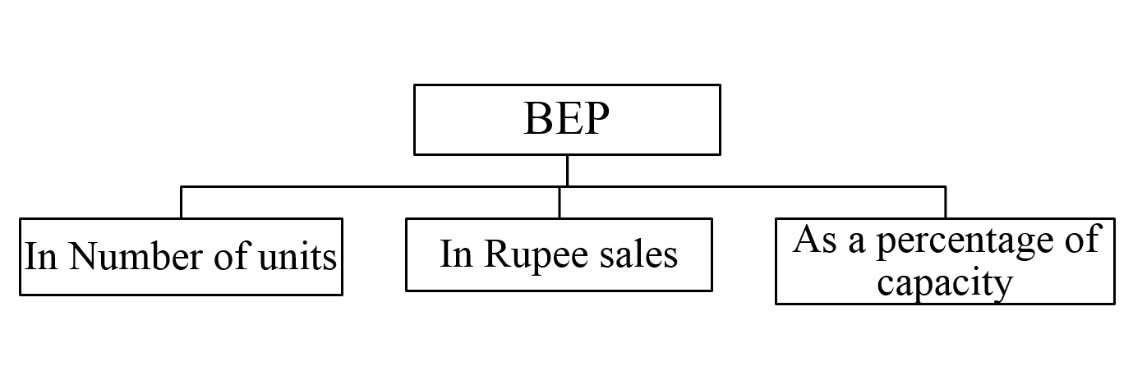
Break Even Point – Formula Approach
Break Even Point can be expressed in three ways:

Slide 10
Break Even Point - in Units
Fixed Cost
Break Even Point (in Units) = --------------------------
Contribution Per Unit
Contribution Per Unit = Selling Price per unit – Variable Cost per unit

Slide 11
Break Even Point – In Rupee Sales
Fixed Cost
Break Even Point (in Rupees) = -----------------
P/V Ratio
Variable Cost (TVC)
P/V Ratio = 1 - -------------------------
Sales (Total)

Slide 12
Break Even Point – As a Percentage
Fixed Cost
Break Even Point (as a Percentage) = ---------------------- X 100
Total Contribution
Total Contribution = Total Sales – Total Variable Cost (TVC)

Slide 13
CVP Analysis Assumptions
1. Total cost can be separable into Fixed and Variable components:
a). Total Fixed cost remains unchanged with changes in
sales volume.
b). The variable cost per unit is constant and the total variable cost changes
in direct proportion with sales volume
2. The selling price per unit remains constant, i.e., it does not change because
of volume or because of other factors
3. The firm manufactures only one product. If there are multiple products, sales
mix does not change.
4. Production and Sales are synchronized in such a way that inventories
remain the same.

Slide 14
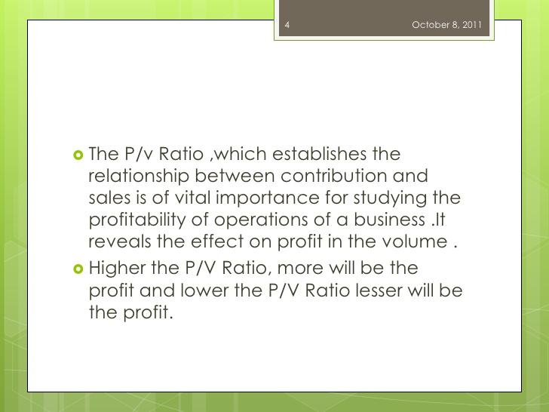
P/V Ratio

Slide 15
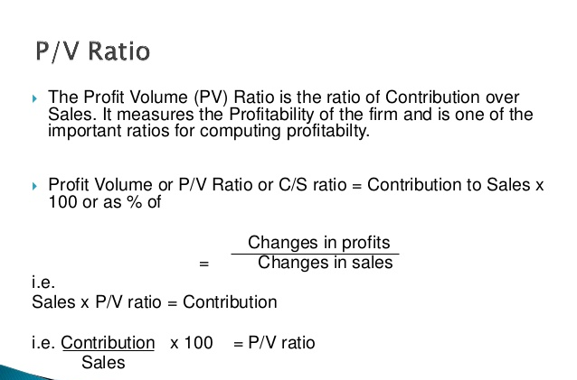

Slide 16


Slide 17
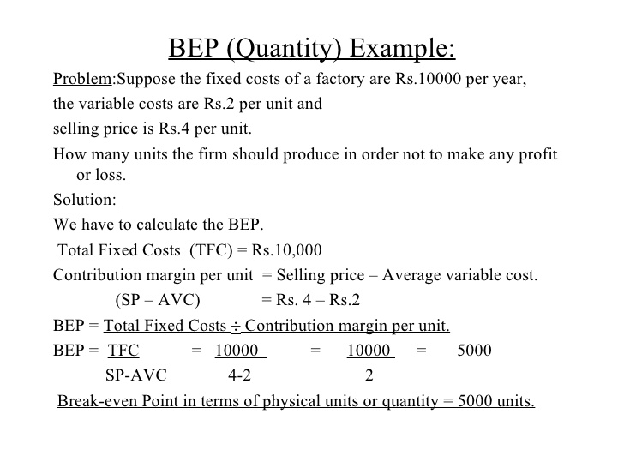
BEP Analysis – Practice problems

Slide 18
1) From the following data calculate BEP .
Selling price per unit = 50 Rs.
Variable cost per unit= 30 Rs.
Fixed Cost = 200000 Rs.
Answer: 10000 Units
2) From the following information find out the amount of profit earned during the year
Fixed cost = 500000 Rs.
Selling price per unit = 15 Rs.
Variable cost per unit = 10 Rs.
Output level = 150000 units
Answer: 250000

Slide 19
3) From the following data, calculate Break-even point. Sales = 800000 Rs. Fixed Expenses 200000 RS Variable expenses: Direct material = 180000 Direct Labor = 120000 Other variable Expenses = 100000 ___________ Total VC = 400000 Rs. ____________ Answer:400000 Rs
4) Calculate BEP with the help of following details: Sales = 500000 Rs. Fixed cost = 100000 Rs. Profit = 150000 Rs. Answer: 200000 Rs.

Slide 20
Margin of Safety
The excess of actual or budgeted sales over the Break-Even Sales is known as
Margin of Safety
Margin of Safety indicates the extent to which sales may fall before a firm suffer a loss.
Larger the Margin of Safety, safer is the firm. High margin of safety is particularly significant in the times of depression when the demand for the firm’s product is falling.
A low margin of safety may be the result of the firm having low P/v Ratio. When both Margin of safety & P/v Ratio are low, the management should seriously think of possibilities of increasing the selling price.

Slide 21
Margin of Safety - Formula
Margin of Safety = Actual/Budgeted Sales – Break even Sales
Actual/Budgeted Sales – Break even Sales
Margin of Safety Ratio = ----------------------------------------------------------- X100
Actual/Budgeted Sales

Slide 22
BEP Analysis – Practice problems
5) Calculate Margin of safety (MOS) and P/v ratio with the help of following data:
Sales = 300000 Rs.
Fixed Expenses = 75000 Rs.
Variable Expenses
Direct Material = 100000 Rs.
Direct Labor = 60000 Rs.
Direct expenses = 40000 Rs.
Answer: BEP = 225000 Rs.
MOS = 75000 Rs.

Slide 23
6) Determine the amount of fixed cost or expenses and calculate BEP sales from the following particulars.
Sales = 500000 Rs.
Direct Material = 150000 Rs.
Direct labor = 120000 Rs.
Direct Expenses= 60000 Rs.
Profit = 70000 Rs.
Answer : Fixed Cost = 100000 Rs.
BEP sales = 294118 Rs.
7) From the following figures calculate sales required to earn a desired profit of 120000 Rs.
Sales = 600000 Rs.
Variable cost = 375000Rs.
Fixed cost = 180000 Rs.
Answer: Sales required : 800000 Rs.

Slide 24
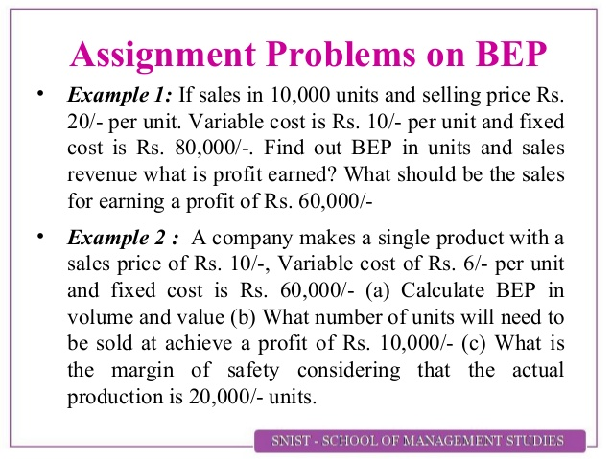
8) From the following data calculate Number of units that must be sold to earn a profit of 150000 Rs.
Selling price per Unit = 50Rs.
Variable cost per Unit = 30Rs.
Fixed cost = 200000 Rs
Answer: No of units required :17500 Units

Slide 25
9) The operating results of a company for the last two years are as follows:
YEAR SALES(Rs) PROFIT(Rs)
2004 270000 6000
2005 300000 9000
Calculate 1) P/v ration 2) BEP
Answer: P/v Ratio = 10%
BEP = 210000 Rs
Contribution = 27000 Rs.
10) calculate BEP in terms of units and in terms of sales from the following particulars:
Fixed cost = 300000 Rs.
Variable cost per Unit = 15 Rs.
Selling Price Per Unit = 20 Rs.
Answer: BEP Units = 60000 : Rupees: 1200000 Rs.

Slide 26
11) the following data are obtained from the records of a manufacturing company:
YEAR SALES(Rs) PROFIT(Rs)
2009 80000 10000
2010 90000 14000
Calculate 1) P/v ration 2) BEP Answer: P/V Ratio = 40%
BEP = 55000 Rs.
12) The operating result of a company for the last Two periods are as follows:
PERIOD SALES(Rs) PROFIT(Rs)
I 270000 6000
II 300000 15000
Calculate: 1) P/v ration
2) BEP
3) Sales required to earn a profit of 20000 Rs.
4) Profit when the sales are 500000 Rs.
Answer: P/v Ratio = 30%, BEP = 250000 Rs.
Sales required= 316667 Rs.
Profit required = 75000 Rs.

Slide 27
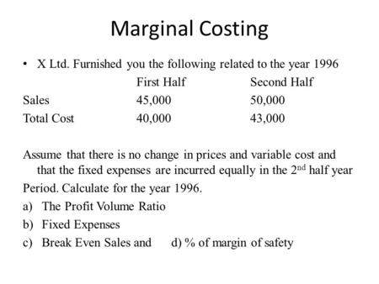

Slide 28
Break Even Chart
Break Even Chart portrays pictorial view of the relationship
between Revenues, Costs and Volume.
Break even point indicated in the chart will be the one at which where the
Total sales line and Total cost line intersect.
The intersection point is known as Break Even Point.

Slide 29
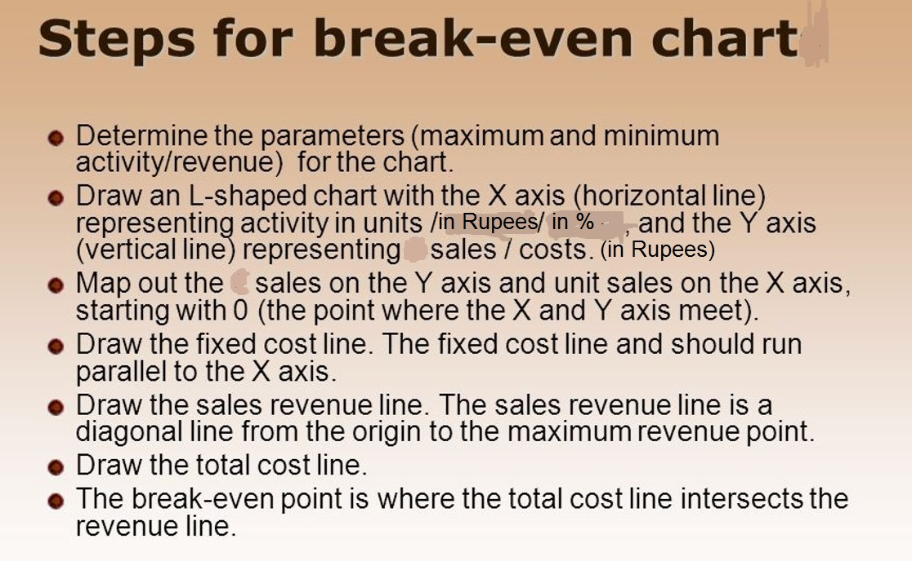

Slide 30
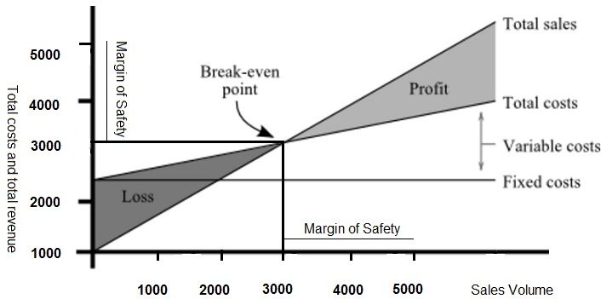

Slide 31
Angle of Incidence
The Angle that is formed between Sales line and Total Cost line after the Break-Even Point is known as Angle of incidence.
The angle of incidence shows the rate at which a company is making profits. The simple rule is that the bigger the angle of incidence higher is the rate of profit.
Larger the Angle of incidence, more profitable is the firm.

Slide 32
Benefits of CVP Analysis
1. to ascertain the profit on a particular level of sales volume or a given capacity level
2. to calculate sales required to earn a particular desired level of profit
3. to compare the efficiency of the different firms.
4. to decide what sales mix will yield optimum level of profit.
5. to decide whether to add/discard a particular product from the existing product line.
6. to assess the impact of changes in fixed cost, variable cost or selling price on BEP and
profits during a given period.

Slide 33
Limitations of Break-even Analysis
1. It is difficult to separate costs into fixed and variable components
2. It is not correct to assume that total fixed cost would remain unchanged
over the entire volume range.
3. The assumption of constant selling price and unit variable cost is not valid.
4. It is difficult to use the Break-even analysis for a multi-product firm.
5. The break- even analysis is a short run concept and has a
limited use in the firm’s long-range planning
6. The break-even analysis is a static tool.

Slide 34
1. Sales Rs.1,00,000
Profit Rs.10,000
Variable Cost 70% of Sales
Find out (i) P/V ratio (ii) Fixed Cost (iii) Sales volume to earn a profit of Rs.40,000
2. Sale of a product amounts to 200 units per month at Rs.10 per unit. Fixed overhead cost is Rs.400 per month and variable cost is Rs.6 per unit. There is proposal to reduce prices by
10 per cent. Calculate the present and future P/V ratio. How many units much be sold to earn the present total profits?

Slide 35
Two firms, X Ltd., and Y Ltd., sell identical products in the same market.
Their profit and loss accounts for the year ending on 30 June 2020 are as follows:
X Ltd., Y Ltd.,
Rs. Rs.
Sales 4,00,000 4,00,000
Less: Variable Costs Rs.3,20,000 Rs.2,80,000
Fixed Costs 40,000 80,000
----------- 3,60,000 ----------- 3,60,000
------------ -------------
Net Profit 40,000 40,000
You are required to:
1. Calculate the Break even point for each firm and
2. State what shall be the likely effect on the profits of the firms in conditions of
(i). Increasing demand for the product
(ii). Falling demand for the product.++

Slide 37
1. You are required to calculate:
i). Margin of Safety
ii). Total sales
iii). Variable cost
Fixed cost Rs.12,000
Profit Rs.10,000
Break-even Sales Rs.60,000
2. The P/V Ratio of Matrix Books Ltd., is 40% and the Margin of Safety is 30%.
You are required to work out the BEP and Net Profit, if the Sales Volume is Rs.14,000.

Slide 38
Review Questions on Break Even Analysis
Define Break Even Point?
What is P/V Ratio
Assumptions underlying Break Even Analysis
What is Margin of Safety?
State the uses of Break Even Analysis
What are the limitations of Break even Analysis?
What is “Angle of Incidence”?

Slide 39

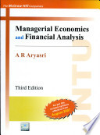
Reference

